Slide 1
Collect P2000 notifications
Language detection &
spell check ( P2000)
Create database of P2000
Notification codes
Indexing of notifications
Collect news feed / twitter data
Language detection &
spell check (News/Twitter)
Indexing of news feed /
twitter data
Cluster notifications
Retrieving keywords from
P2000 notifications
Cluster news feed / twitter data
Classify P2000 notifications
Association analyser
Classify news feed / twitter data

Slide 2
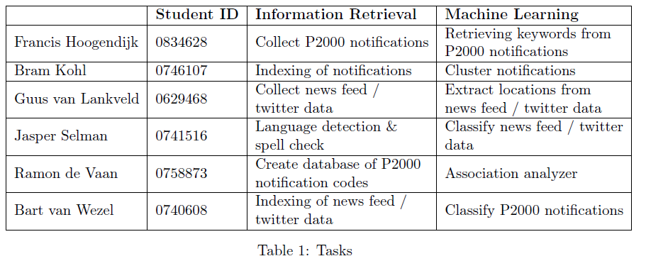

Slide 3
Collect P2000 notifications
Language detection &
spell check ( P2000)
Create database of P2000 Notification codes
Indexing of notifications
Collect twitter data
Collect news feed
Cluster notifications
Retrieving keywords from
P2000 notifications
Language detection &
spell check (News/Twitter)
Classify P2000 notifications
Indexing of news feed /
twitter data
Association analyser
Cluster news feed / twitter data
Classify news feed / twitter data

Slide 4
Collect P2000 notifications
Create database of P2000 Notification codes
Indexing of notifications
Collect twitter data
Collect news feed
Cluster notifications
Language detection &
spell check (News/Twitter)
Classify P2000 notifications
Association analyser news
Indexing of news feed /
twitter data
Classify news feed / Twitter data
GUI
Association analyser Twitter

